Slide 1


WALLPAPER SUGGESTION THROUGH EMOTION RECOGNITION
TEAM MEMBERS:
RA2011030010011 – Raghul s A
RA2011030010029 - Anirudh ambady
RA2011030010037 – Gayathri G

Slide 2
Table of Contents
Problem Statement
Abstract
System Architecture
Methodology
CNN Layers and Connectivity
Validation

Slide 3
Problem Statement
The goal of an emotion recognition-based wallpaper recommendation system is to create a machine learning model that can effectively identify users' moods from their facial expressions and choose wallpapers that suit their state of mind. This system would examine the user's facial expressions and categorise their emotions into groups like happy, sad, furious, shocked, etc. using computer vision techniques.
The algorithm would then suggest wallpapers that are both aesthetically beautiful and suitable for the user's emotional state based on this research. The system's objective is to improve the user's experience by making customised wallpaper suggestions that are reflective of their present emotions and mood.

Slide 4
ABSTRACT
The system analyses user facial expressions to determine their emotional state, such as happiness, sadness, or anger.
The suggested system employs a support vector machine (SVM) to categories the emotional state and a convolution
By offering personalized wallpaper suggestions based on the user's emotional state, the proposed system has the potential to enhance the user experience.

Slide 5
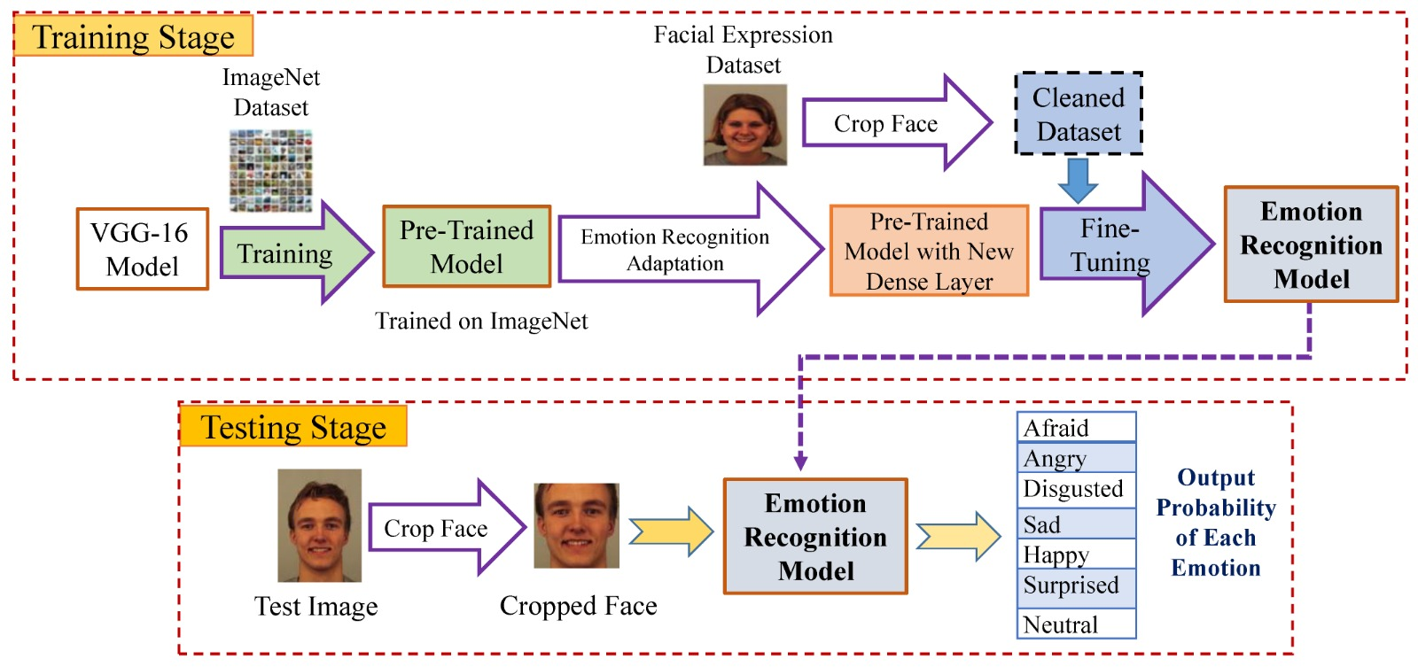
System Architecture
Data collection and Pre-Processing
Emotion Recognition
Wallpaper Recommendation
Integration of Emotion Recognition and Wallpaper
Evaluation and Feedback
Deployment and Scalability

Slide 6
Methodology
Emotion Recognition module
Wallpaper database
Wallpaper Feature extraction module
Recommendation Engine
User Interface
Feedback and Evaluation module

Slide 7
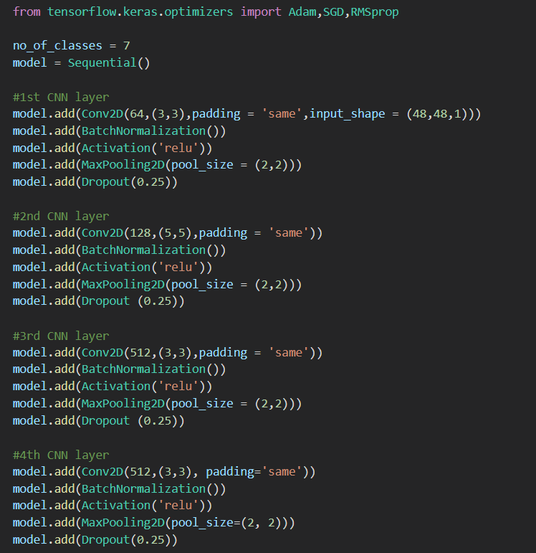
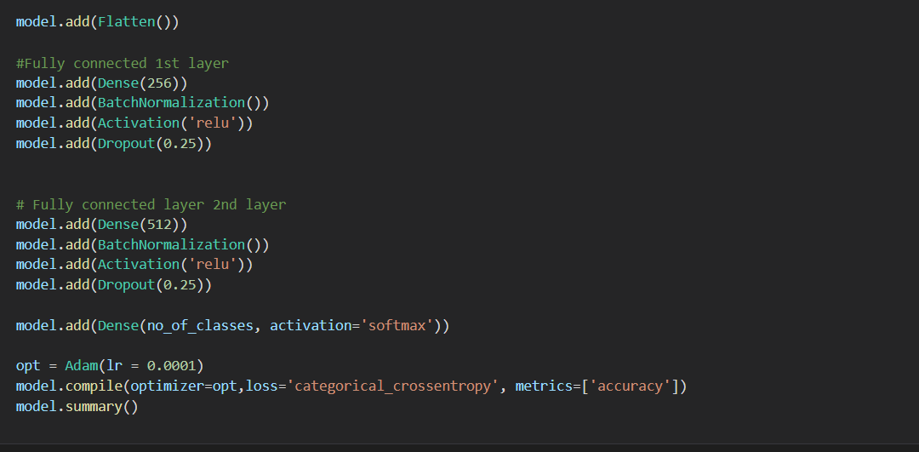
CNN Layer and Connectivity

Slide 8
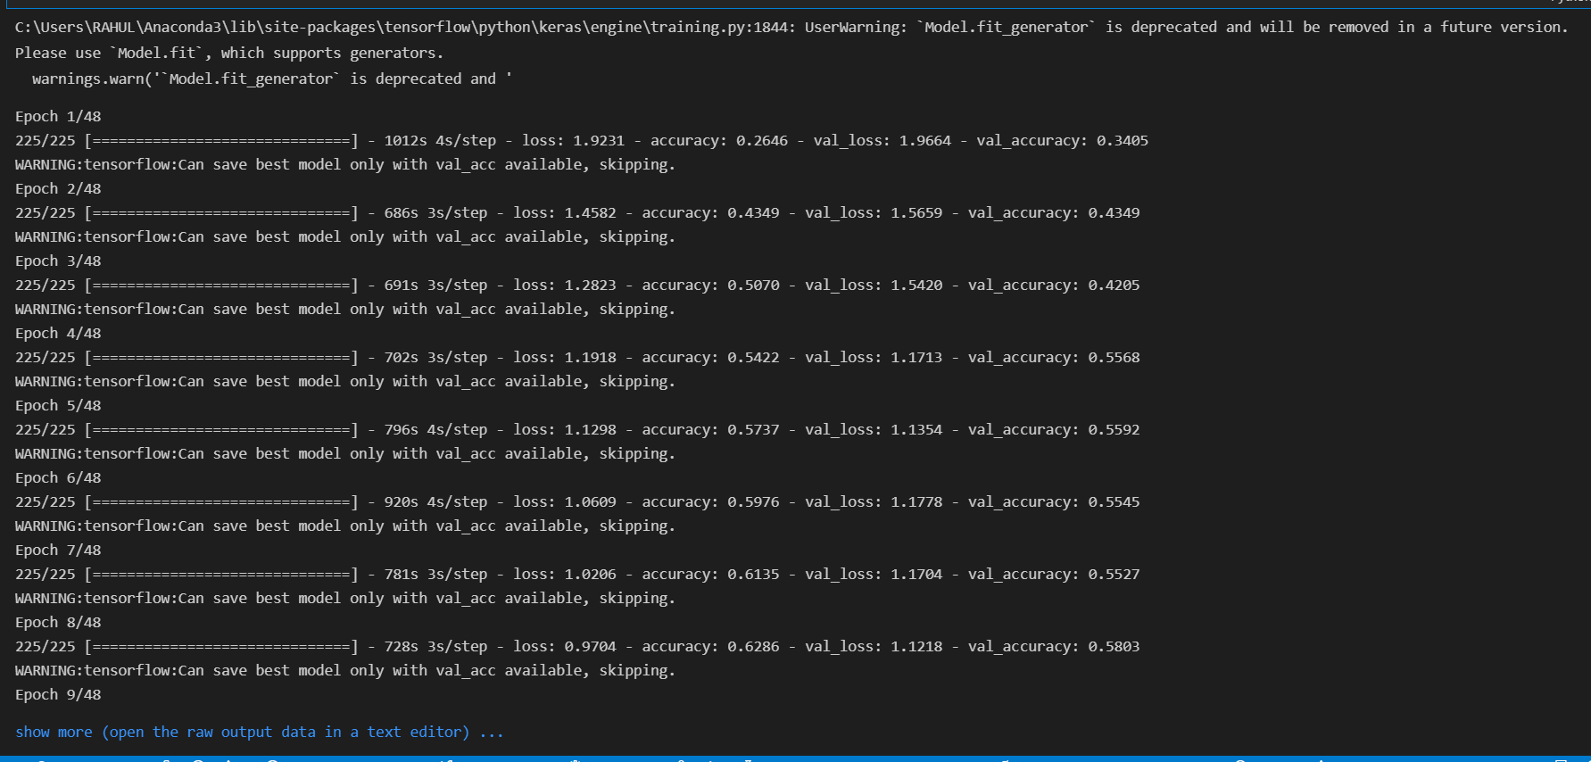
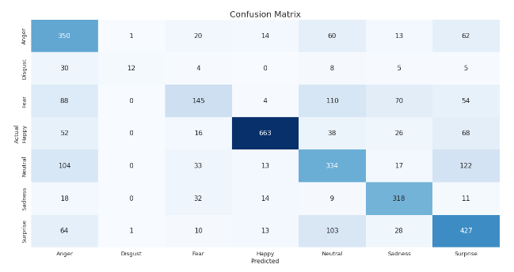
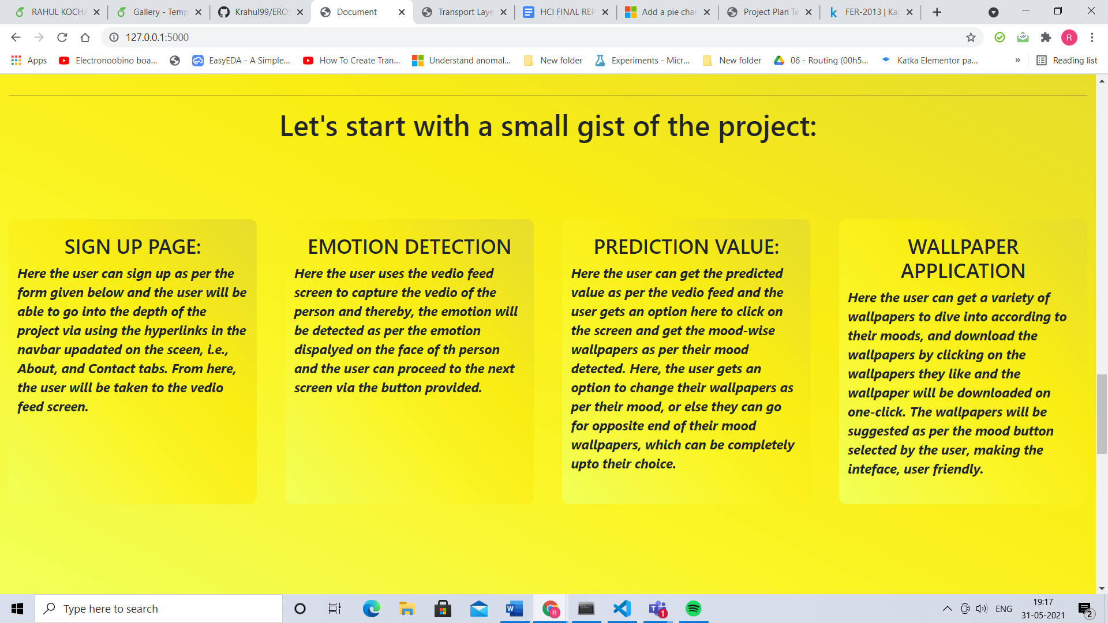
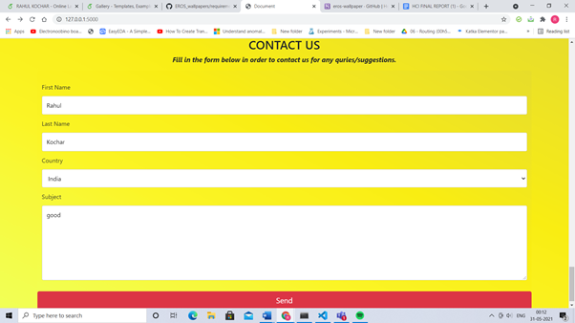
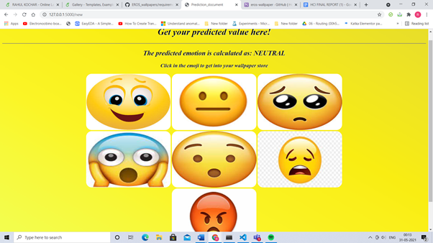
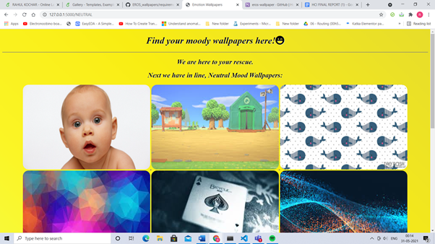
Validation

Slide 9

Thank You!

